Slide 1
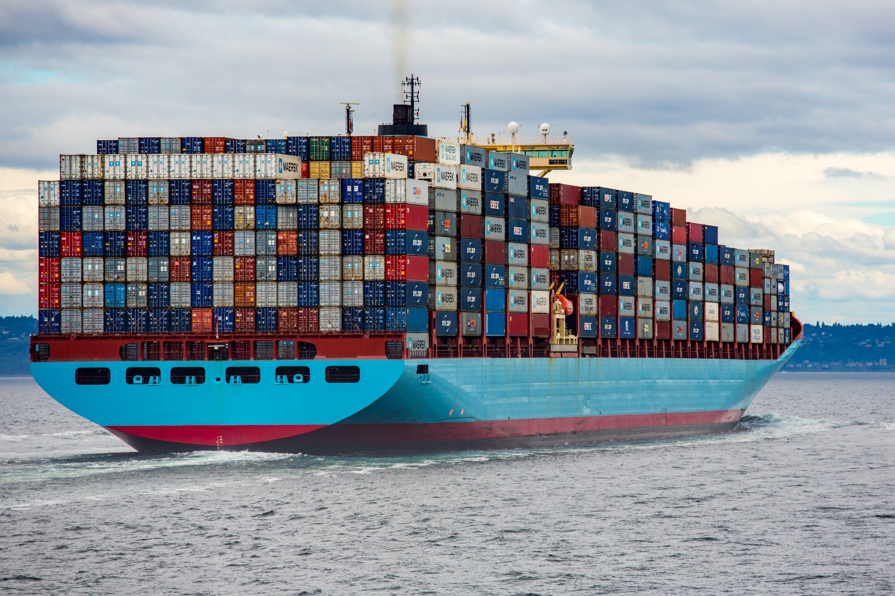
Application Container Apps
A first look

Slide 2
Vocabulary
CNCF: Cloud Native Computing Foundation an open-source foundation dedicated to making cloud-native computing universal and sustainable. https://www.cncf.io/
Dapr: event-driven runtime that makes it easy for any developer to build resilient, stateless and statefull applications for different languages and frameworks – CNCF incubator https://dapr.io/
Bicep: a declerative language to describe Azure resources so they can easily deployed https://aka.ms/bicep
Keda: Kubernetes event-driven autoscaling, scale your cluster based on a wide range of cloud services (Google, Amazon, Microsoft, … ) – CNCF member https://keda.sh/
Envoy: Proxy for ingress functionality and trafic splitting – CNCF member https://www.envoyproxy.io/
Notes:
Bicep: Terraform competitor of Microsoft itself – in a declarative language you can describe your Azure resources – when deploying it translates the yaml files to ARM templates and these templates are deployed.
Dapr: in 2022 I’ll create a specific Dapr overview

Slide 3
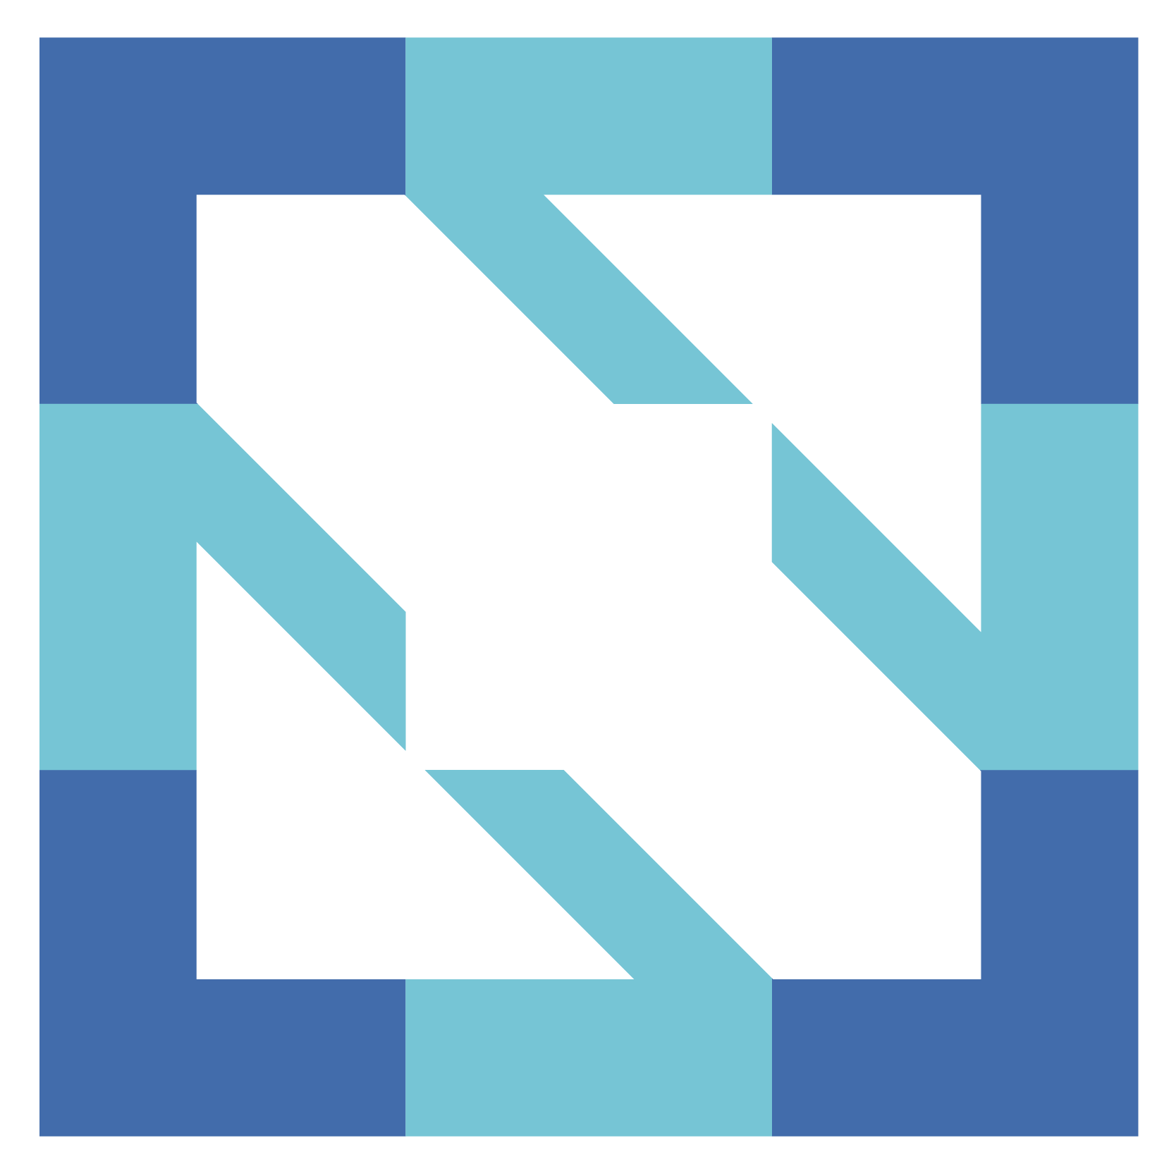
CNCF
CNCF is an open source software foundation dedicated to making cloud-native computing universal and sustainable.
Vendor neutral home for the fastest growing open source projects
Complete landscape https://landscape.cncf.io/

Slide 4

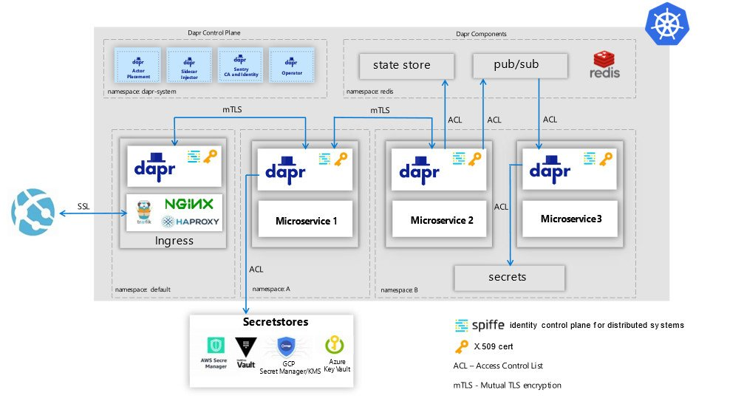
Dapr
Distributed Application Runtime provides API’s that simplify microservice connectivity
To tackle challenges like:
service discovery,
message broker,
encryption,
observability,
secret management

Slide 5
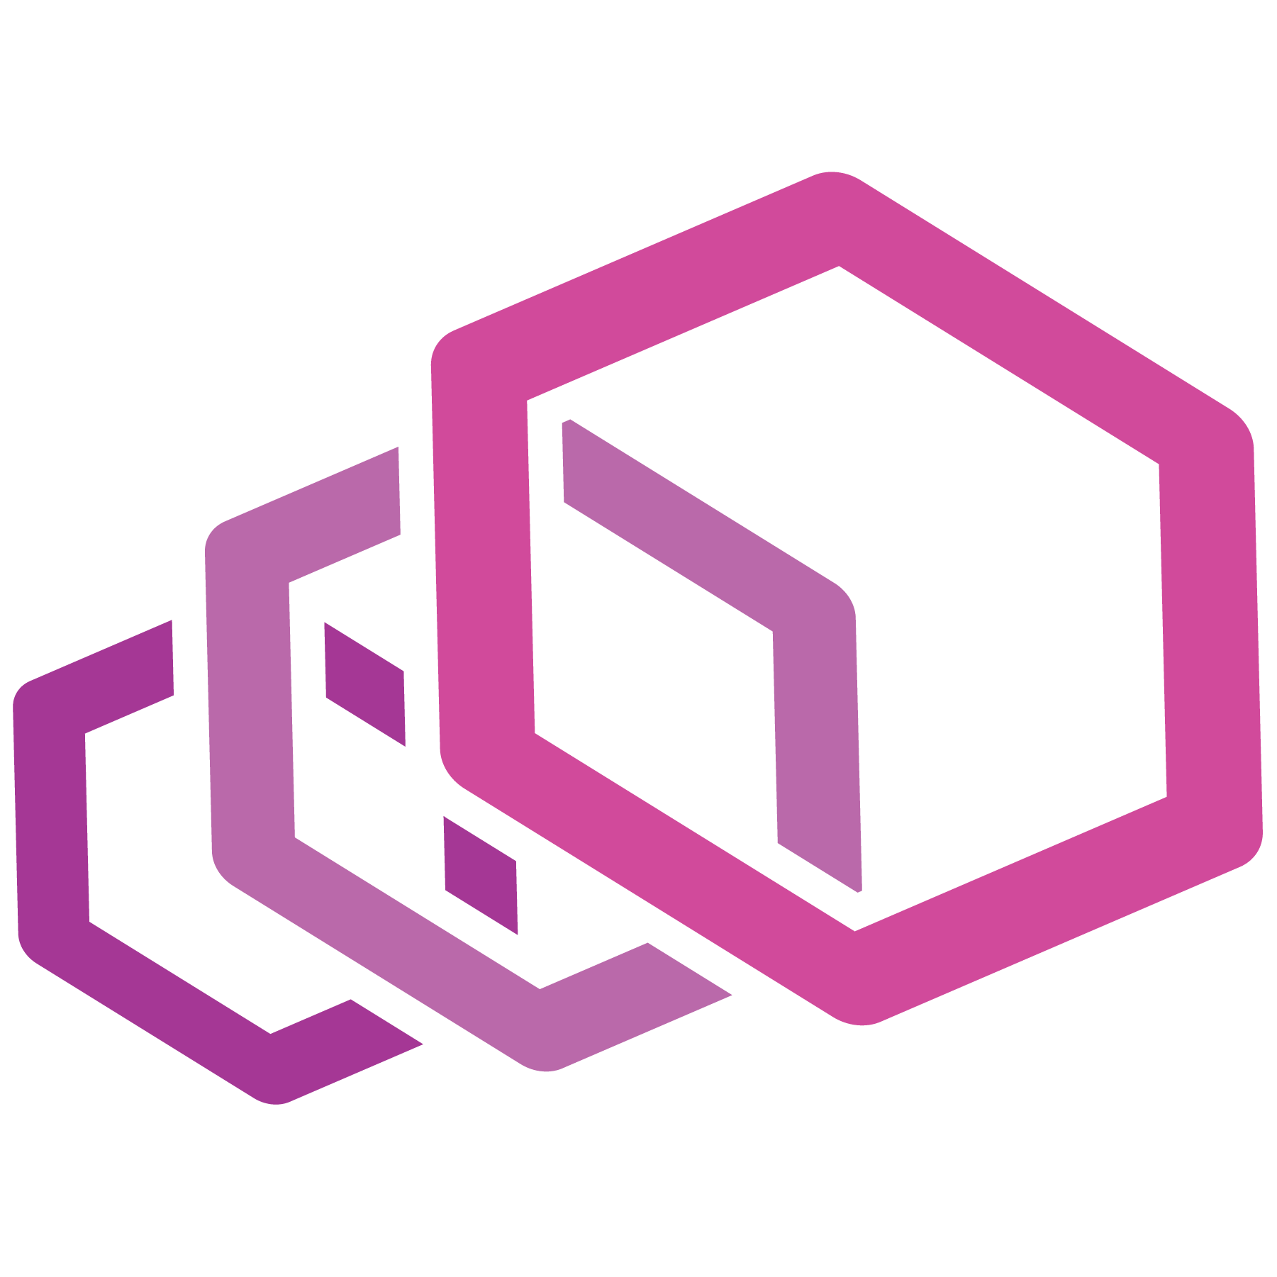
EnVOY
Is a proxy and communication bus designed for large modern service oriented architectures
Self-contained process that runs along the application server
With features like HTTP, TCP routing, filtering, HTTP/2 support, GRPC support, Service discovery, health checking, load balancing, observability, …
https://www.envoyproxy.io/docs/envoy/latest/intro/what_is_envoy

Slide 6
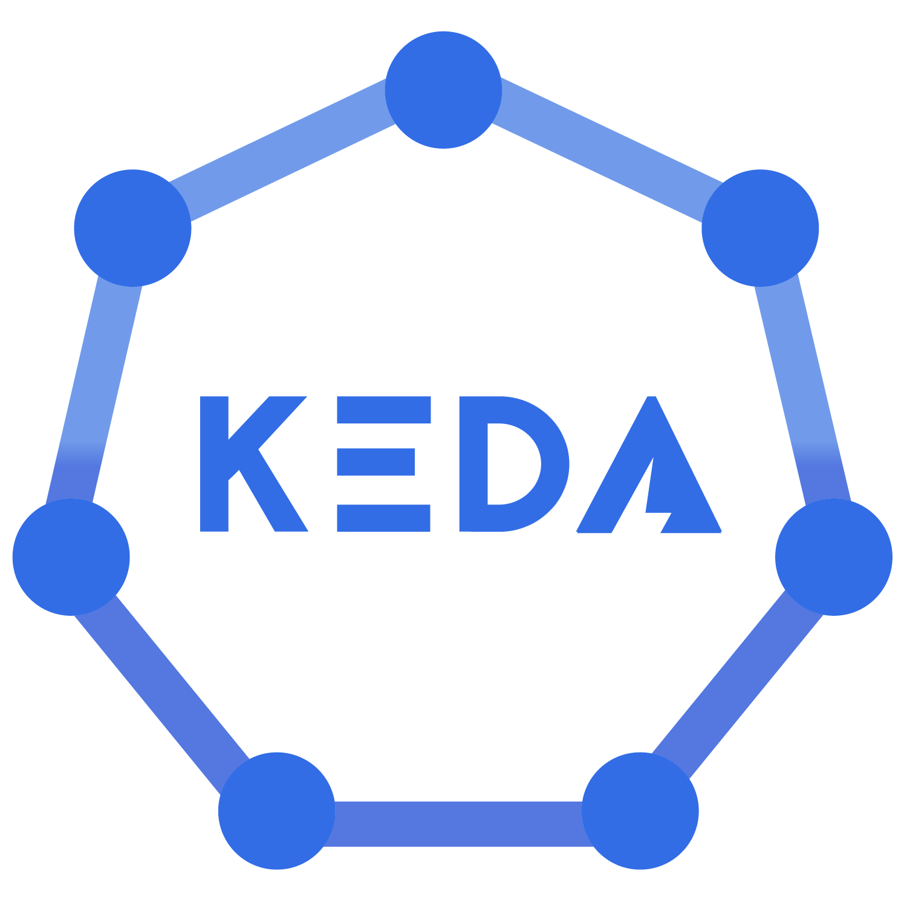
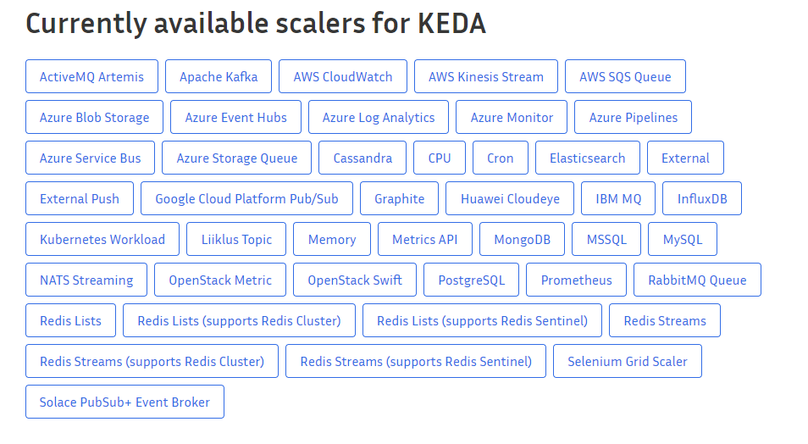
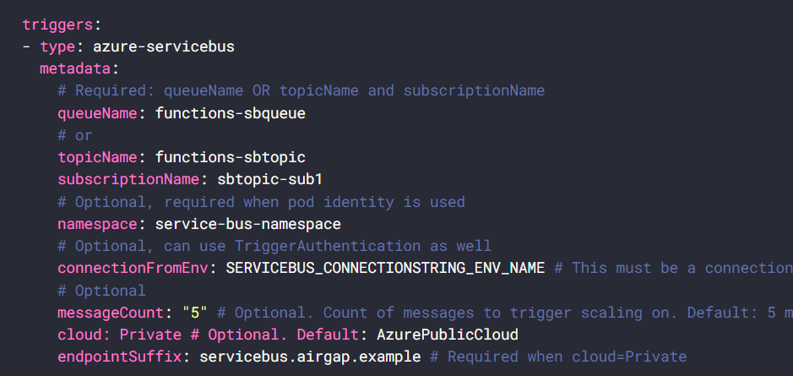
KEDA
Kubernetes based event-driven autoscaler
Based on cloud resources of different cloud vendors

Slide 7
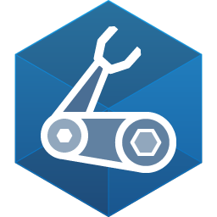
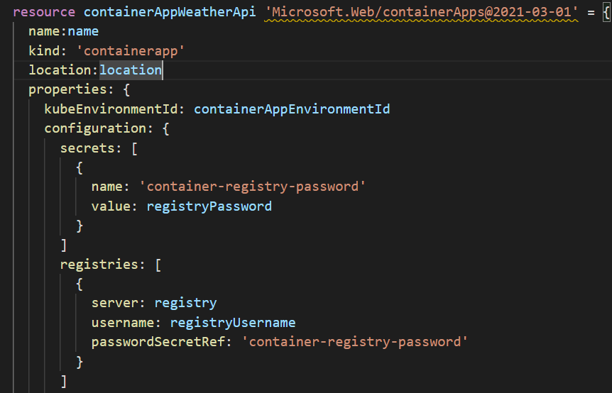
BICEP
Declarative language
When compiled it’s translated to ARM templates
Even Beta features can be deployed with bicep
Difference with Terraform – single vendor (Microsoft), no state

Slide 8
What ARE Azure Container apps
Fully managed serverless container service
Build on AKS
Deploy API Endpoints
Hosting Background applications
Handling event-driven processing
Can scale to 0
Competitors: Google Cloud run, AWS app runner

Slide 9
What can it do?
Run mutliple container revisions
Autscale (keda)
HTTP Ingress (envoy)
Split trafic
Internal ingress and service disconvery
Dapr integration
Can run containers for any registry
Secret Management

Slide 10
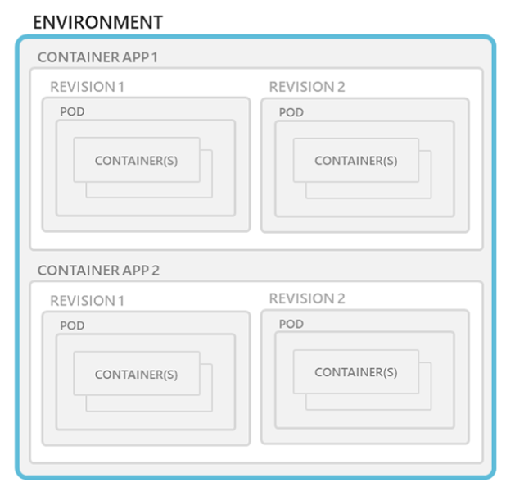
Architecture: Environments
Everything runs in an Enviornment – secure boundary around a group of apps (VNET)
Which can have one or more Apps
A container app can have one or more revisions
Manage related services
Different apps on the same network
Deploy apps that need to communicate with each other
Environments are free

Slide 11
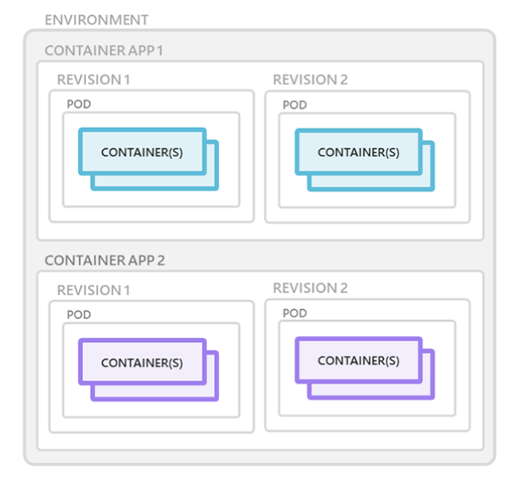
Architecture: Containers
Containers that use any runtime, programmingn language, or dev stack
Linux based containers
No requirement for base image
When a container crashes it restarts automatically
You can run mutiple containers in the same app (sidecar)
That group of containers is known as pods (K8)

Slide 12
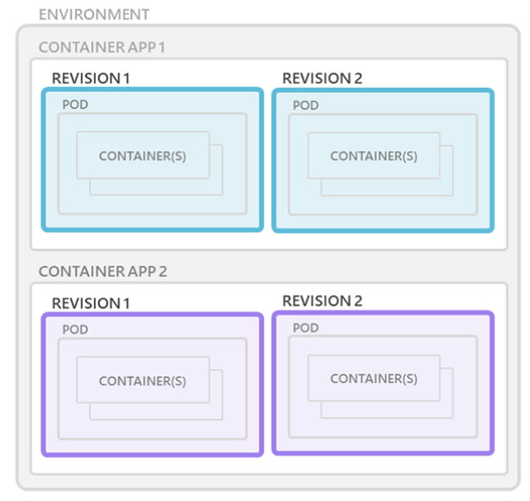
Architecture: Revisions
Revisions are version of your app
New revisions are created when a new image is deployed, App template changes (config)
Revisions are immutable
Can be used for A/B deployment or BlueGreen deployment

Slide 13
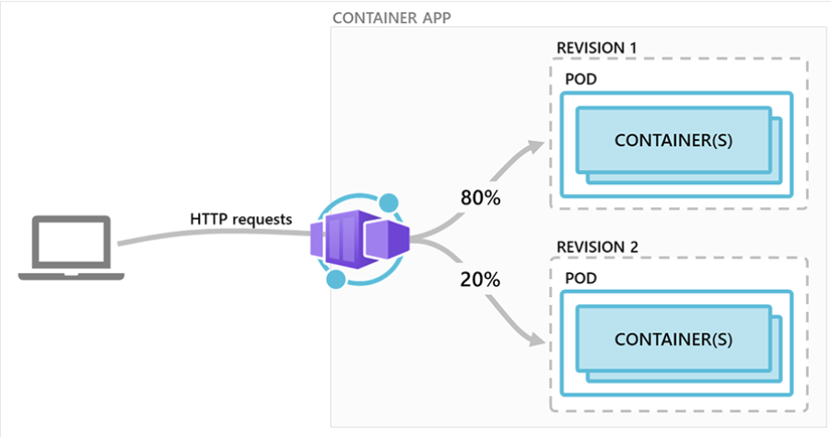
Architecture: Revisions
Can be used for A/B deployment or BlueGreen deployment
Revisions remain active until you deactivate them, or you can configure it to automatically deactivate
Inactive revisions are free
You can have 100 revisions until they are being purged

Slide 14
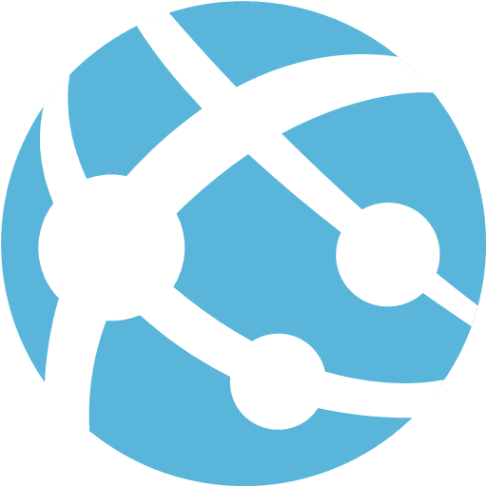

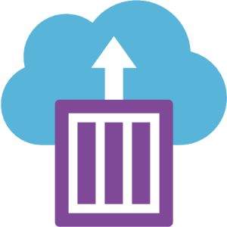
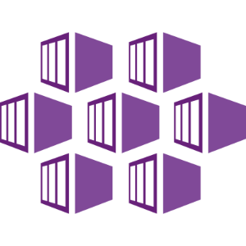
Where does it fit
Web / Func App | ACA | ACI | AKS
Focussed on single websites, or event driven services | Out of the box: certificates,revisions, scale & environments | Ideal for backend processes No concept of scale, load balancing | Full power of kubernetes, but requires experised in configureing and operating kubernetes cluster

Slide 15
Limitations & Roadmap
In Beta and only available in North Europe & Canada Central
Monitoring stil not sufficient
It would be great to see even more CNCF integrations
Managed Identity, keyvault and existing VNET integration are announced and will be released in 2022
Run the Azure Functions Runtime in a container

Slide 16
Demo time

